Slide 1
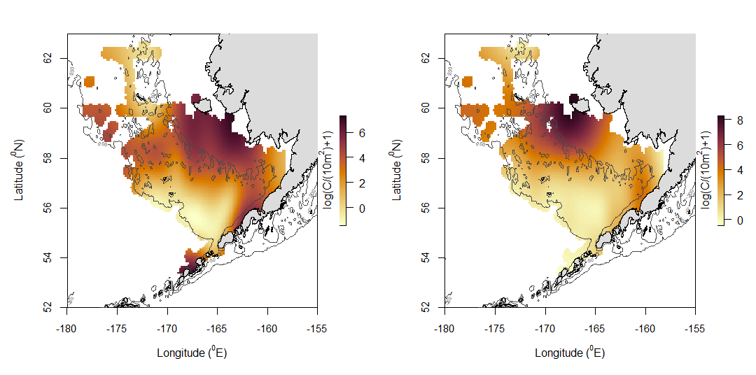
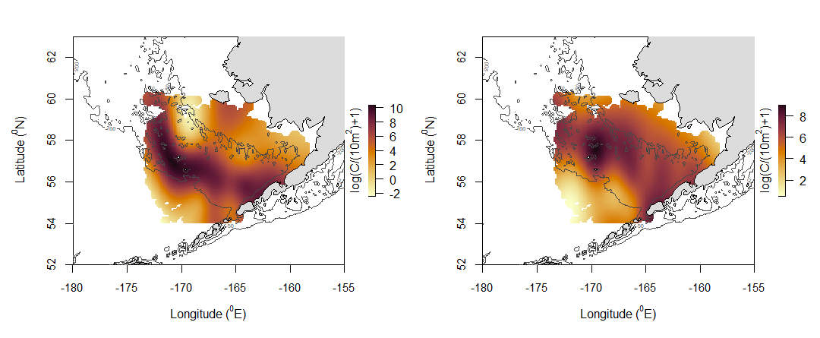
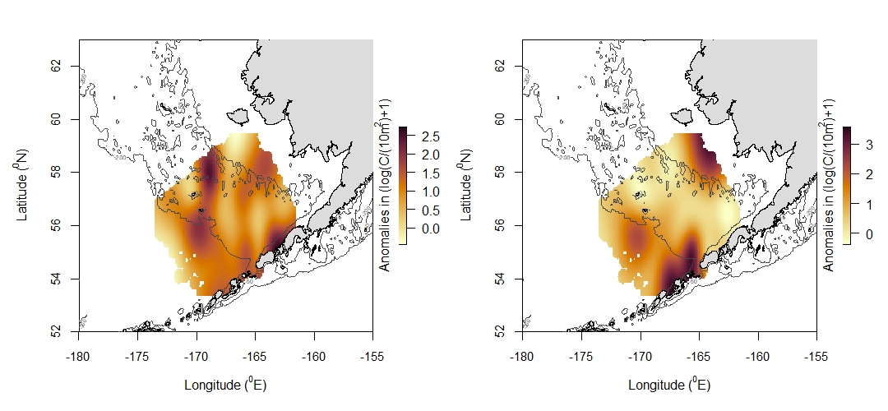
B
AP
A
B
WP
A
B
Rex Sole
A

Slide 2
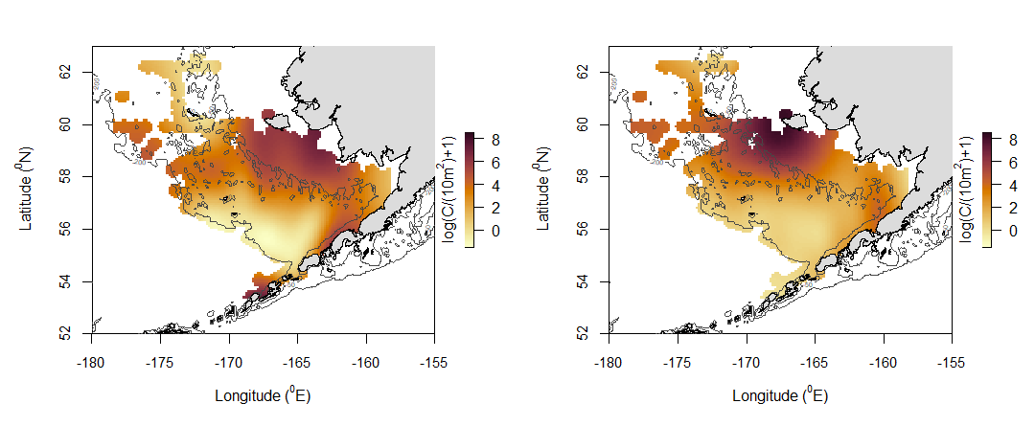
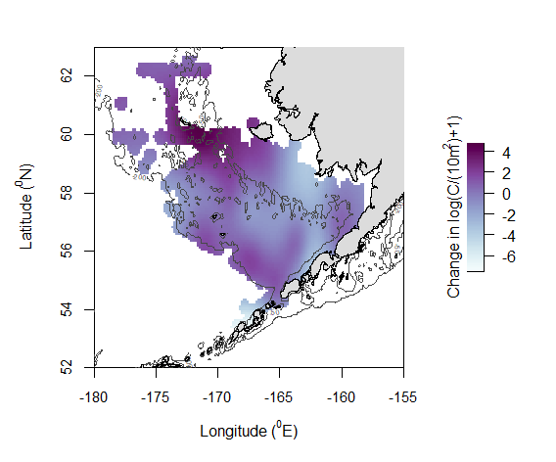
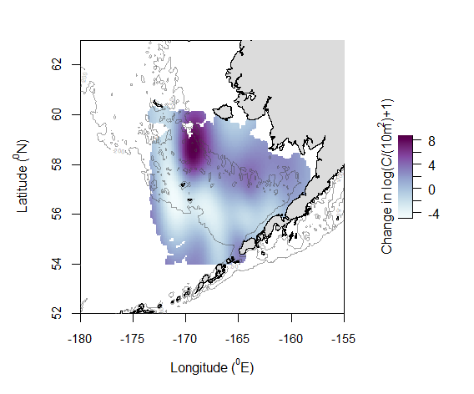
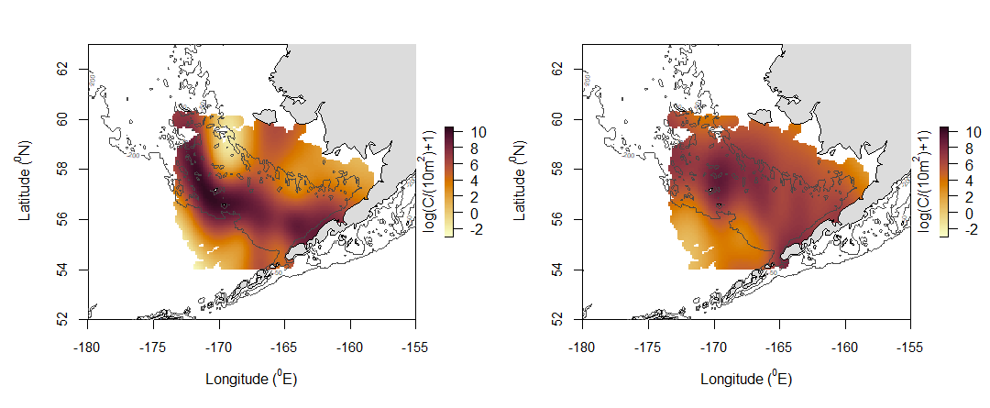
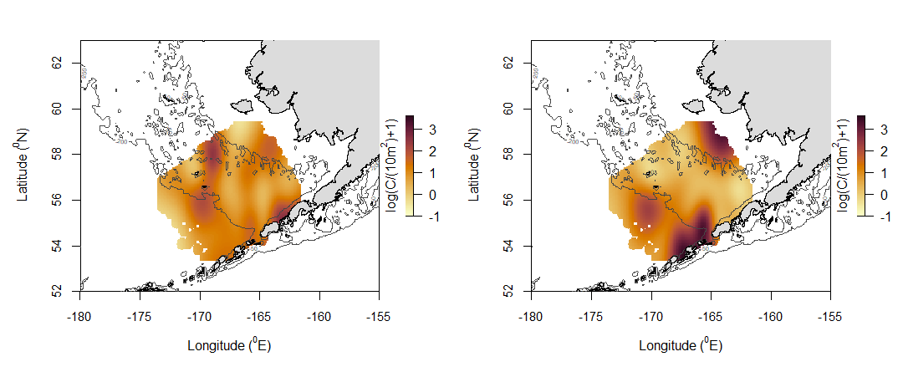
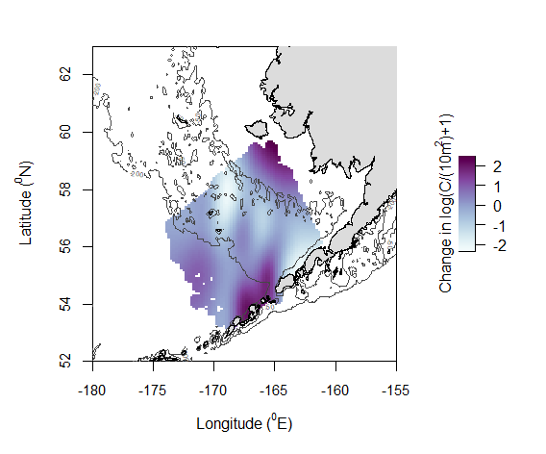
A.1
B.1
C.1
A.2
B.2
C.2
A.3
B.3
C.3
Notes:
Alaska plaice eggs

Slide 3
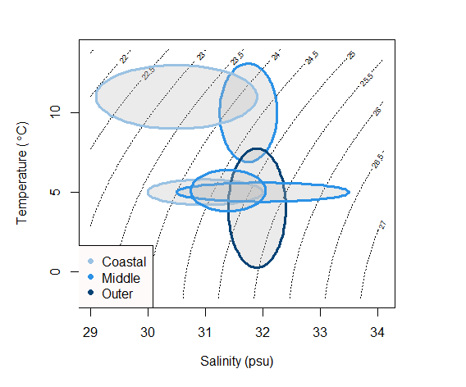
YFS
FHS
AP
WP
NRS
PC

Slide 4
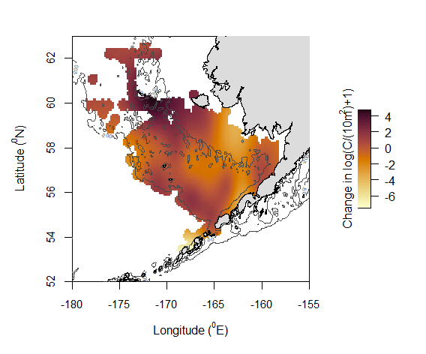
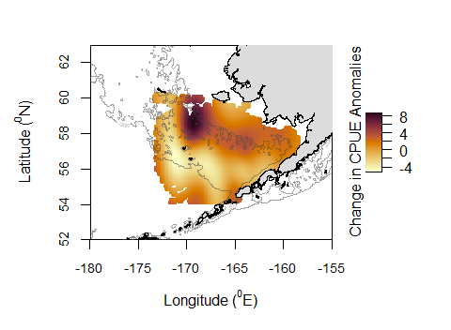
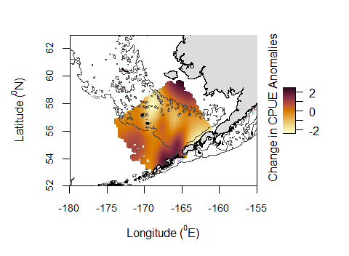
AP
Walleye Pollock
Rex Sole

Slide 5
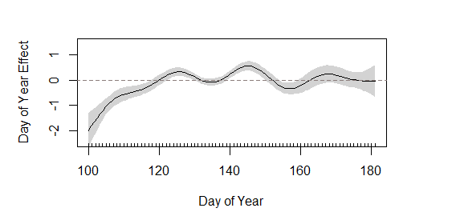
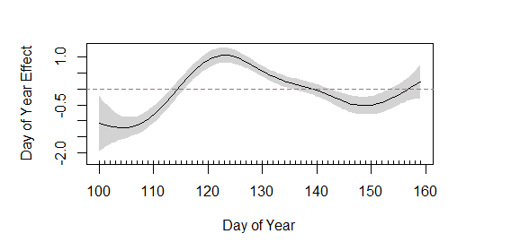
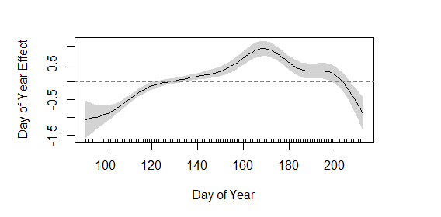
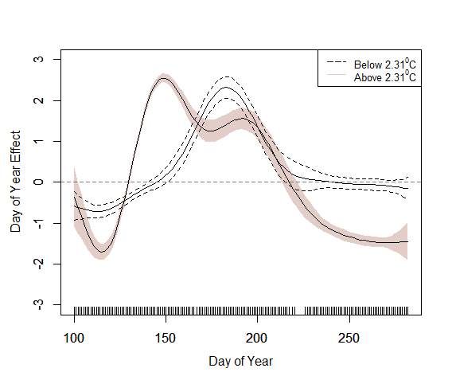
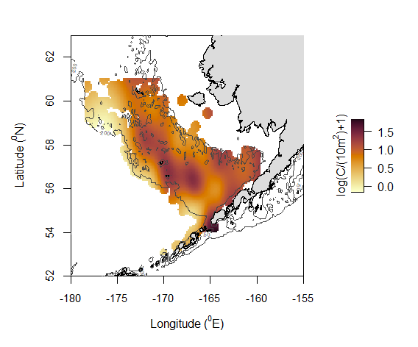
A
B
C
A
B

Slide 6
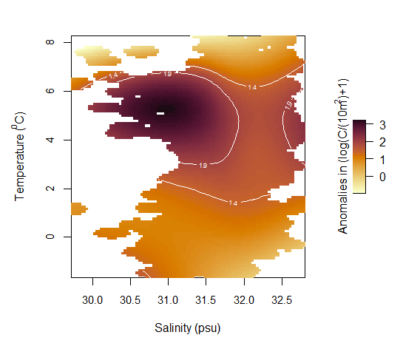
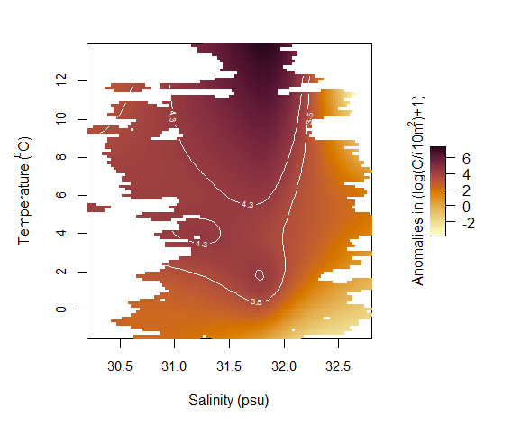
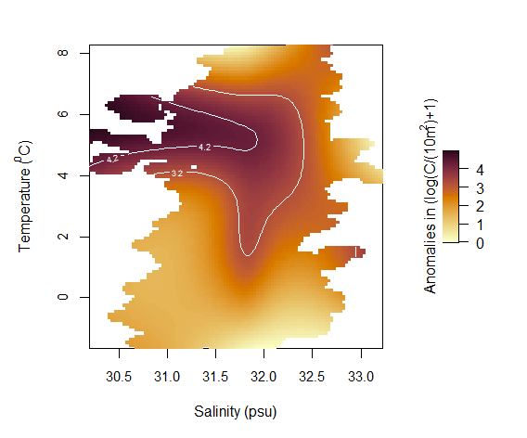
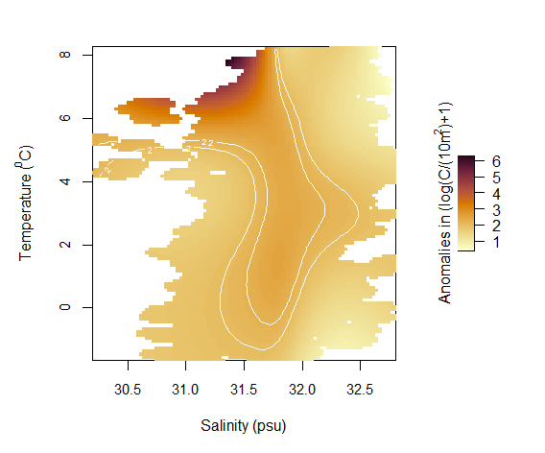
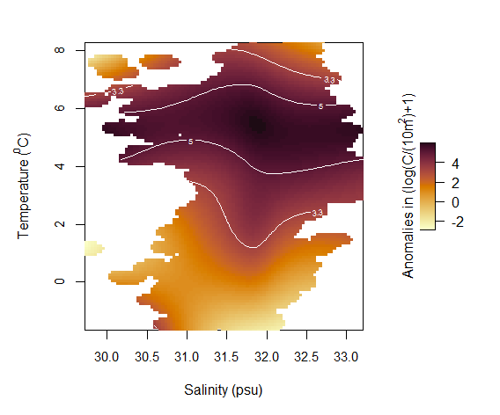
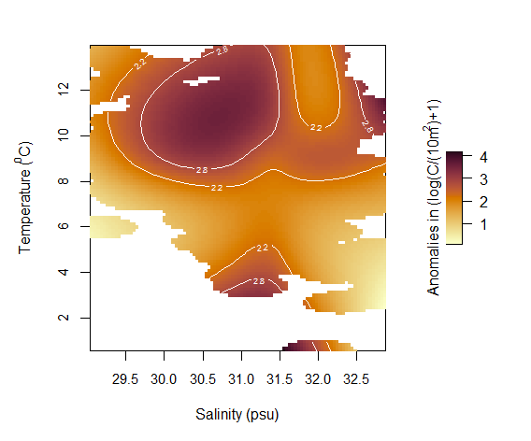
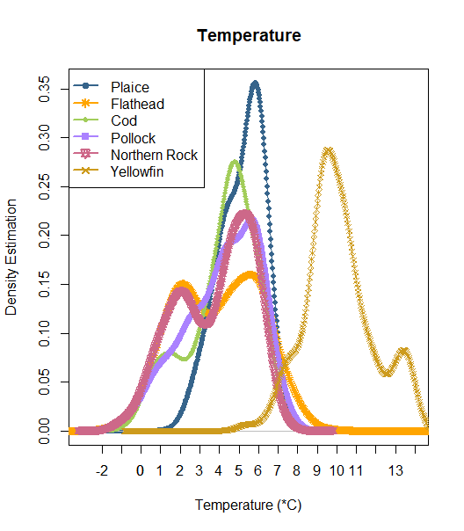
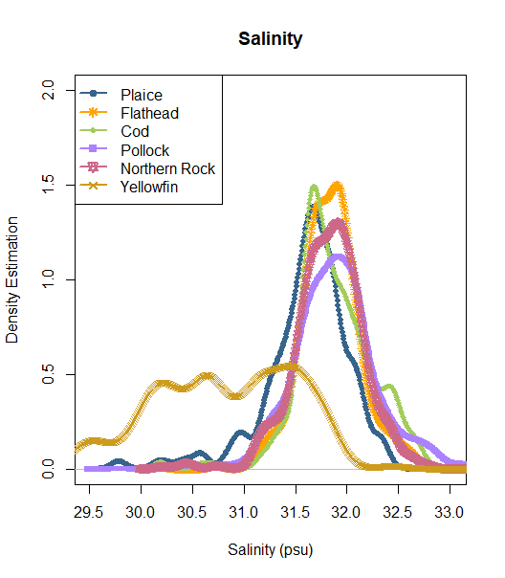
A
B
C
D
E
F
Notes:
A – Alaska plaice
B – Flathead sole
C – Northern rock sole
D – Pacific cod
E – walleye pollock
F – yellowfin sole

Slide 7
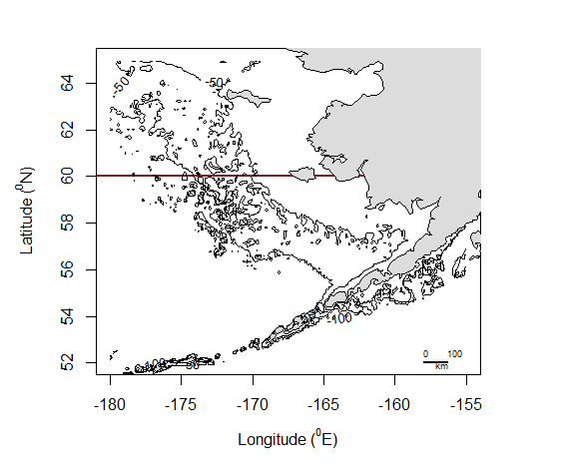
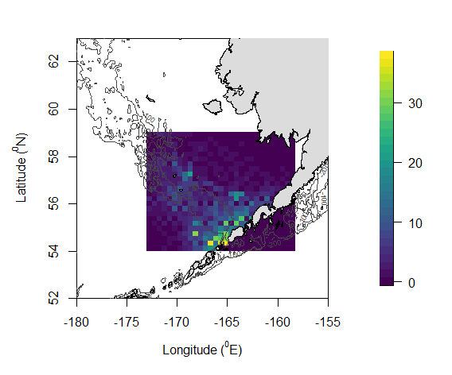
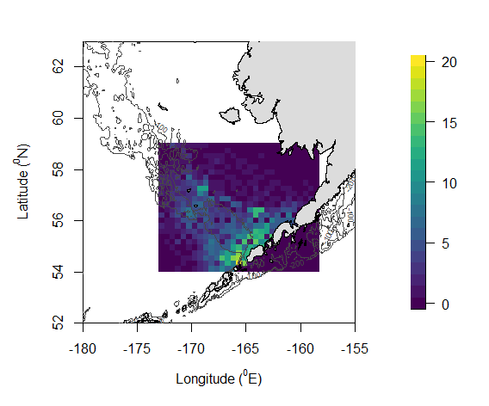
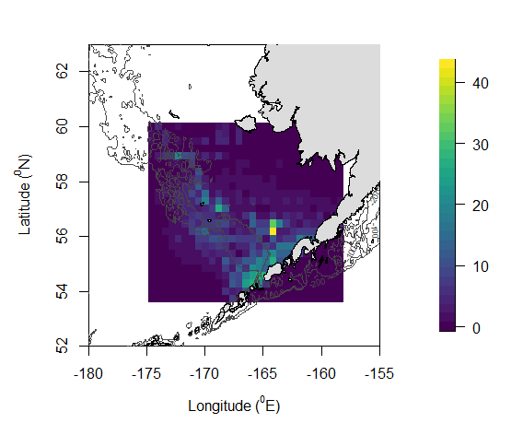
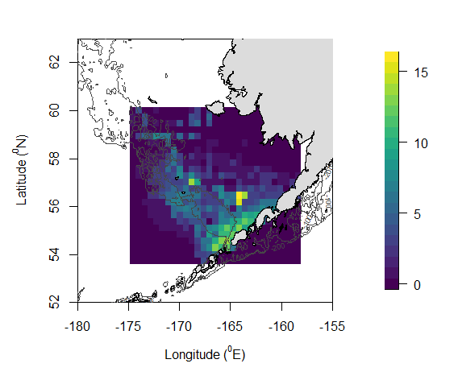
Middle
Coastal
Outer
A. 1
B. 1
Stations Sampled
Stations Sampled
A. 2
B. 2
Years Sampled
Years Sampled

Slide 8
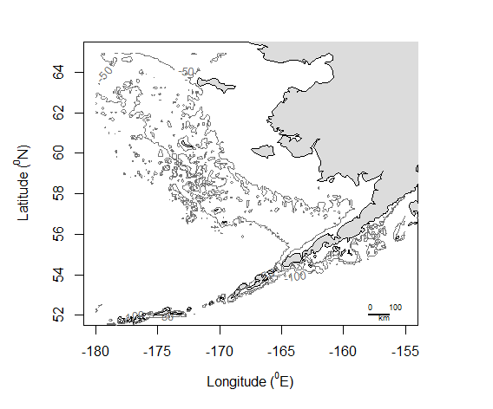
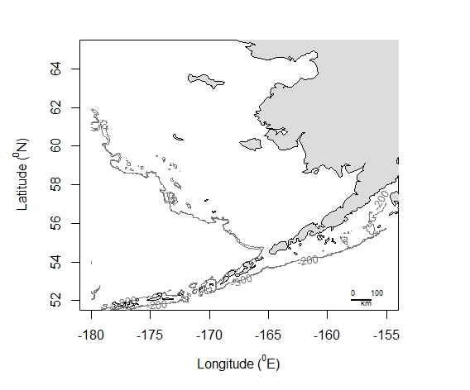
St. Lawrence Island
St. Matthew Island
Nunivak Island
Zhemchug Canyon
Pribilof Islands
Pribilof Canyon
Bering Canyon
Unimak Pass

Slide 9
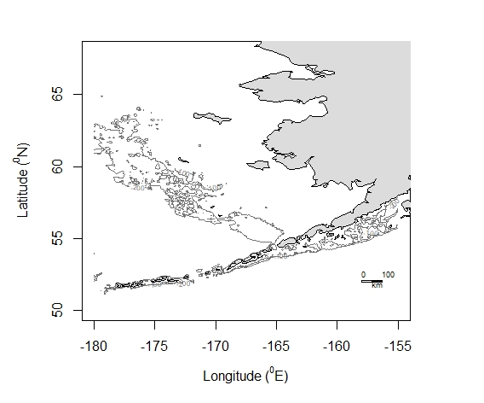
ACC
50-m flow
BSC
100-m flow
ANSC
ACC

Slide 10
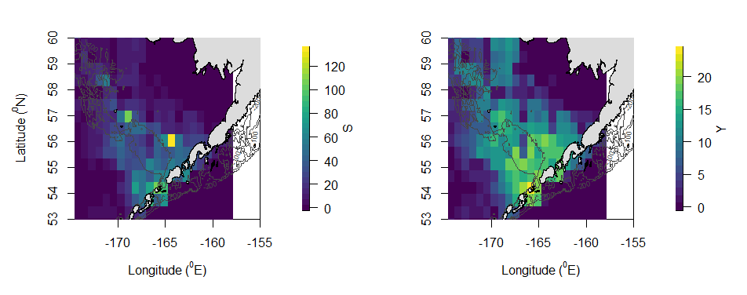
Emmonak
Togiak
St. Paul
Dutch Harbor
Akutan
Stations Sampled
Years Sampled

Slide 11
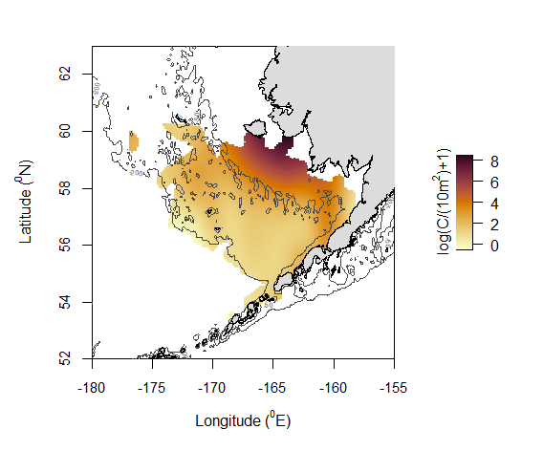
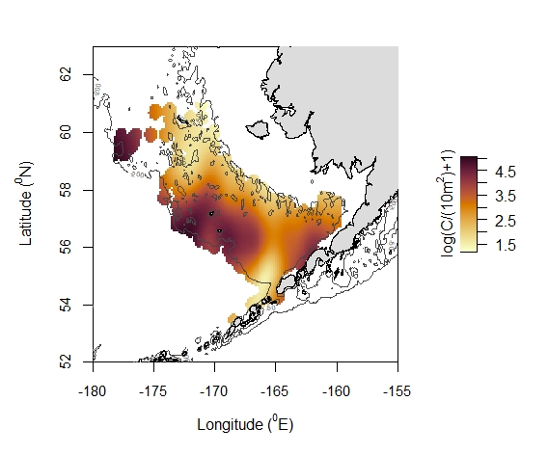
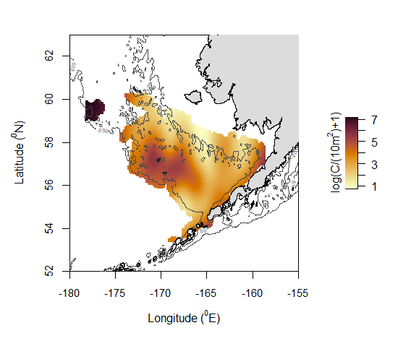
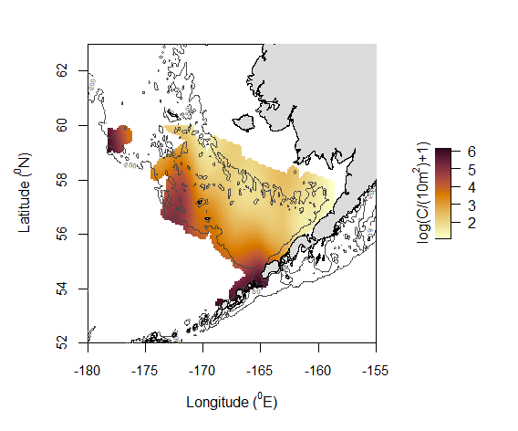
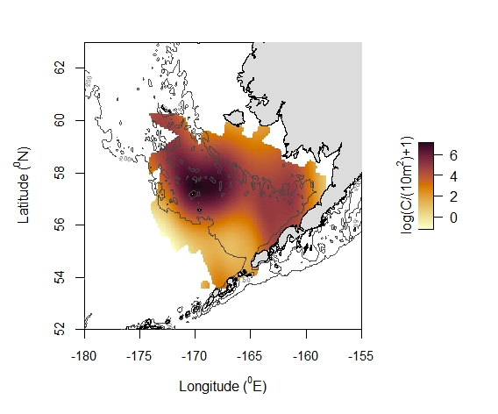
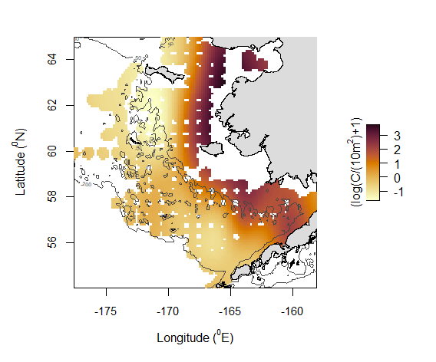
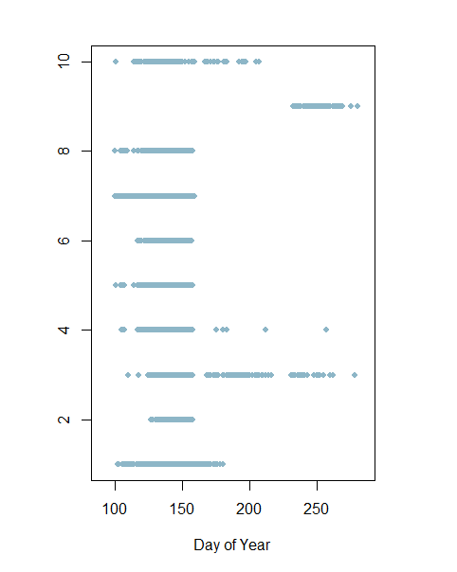
AP
FHS
NRS
PC
WP
YFS
RX, Eggs
YFS, Larvae
PK, Larvae
PK, Eggs
PC, Larvae
NRS, Larvae
FHS, Larvae
FHS, Eggs
AP, Larvae
AP, Eggs
Notes:
1 = Alaska plaice
2 = flathead sole

Slide 12
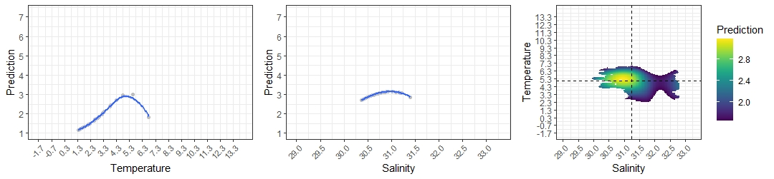
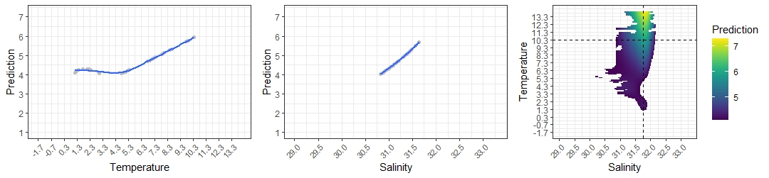
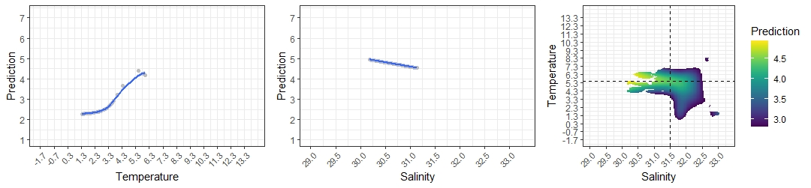
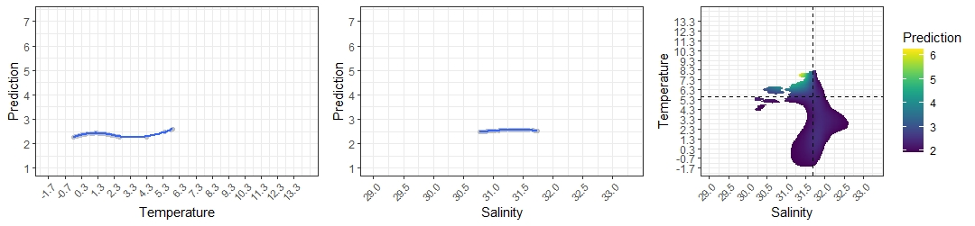
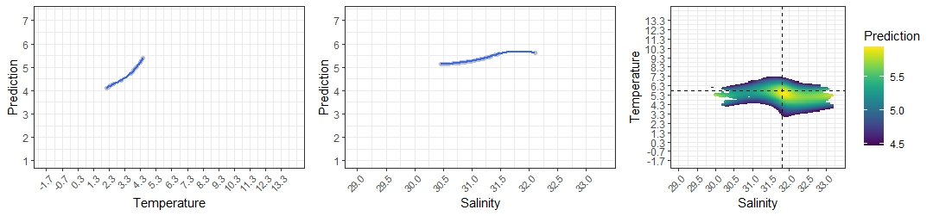
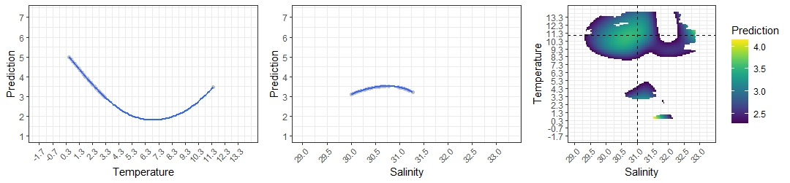
AP
41.78% of T-S area encompasses 60% of total predicted observations**
FHS
62.7%
NRS
71.2%
PC
92%
WP
40.3%
YFS
91.9%
Notes:
To fix all:
Sum predictions
Calculate 60% of the sum (total log(larval CPUE +1))
Determine number of rows needed to get to 0.6*sum
Plot
Determine predictive area (I think… salinity * temperature)
Then determine predictive area of 60% cut
Find the fraction of total area included in the 60% cut

Slide 13
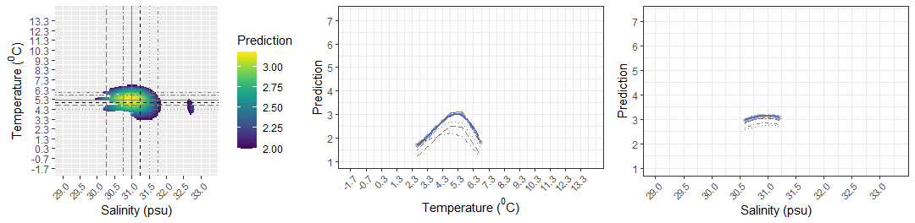
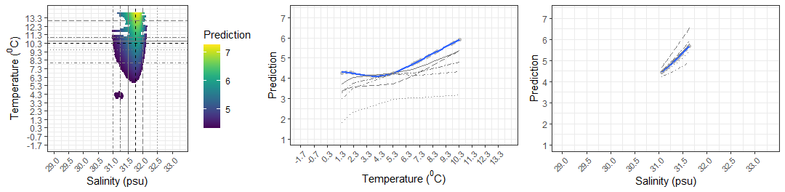




AP
FHS
NRS
PC
WP
YFS
Notes:
To fix all:
Sum predictions
Calculate 60% of the sum (total log(larval CPUE +1))
Determine number of rows needed to get to 0.6*sum
Plot
Determine predictive area (I think… salinity * temperature)
Then determine predictive area of 60% cut
Find the fraction of total area included in the 60% cut

Slide 14







AK
FHS
NRS
PC
WP
YFS
Larval habitat based on temperature and salinity
Larval survival

Slide 15

Notes:
From fishery ecosystem plan BS 2020

Slide 16




Alaska Plaice
Flathead Sole
Walleye Pollock
Rex Sole
Notes:
Eggs

Slide 17




AP
FHS
WP
RS
Notes:
eggs

Slide 18





AP
FHS
NRS
PC
WP
YFS
Notes:
larvae

Slide 19






Alaska Plaice
Pacific Cod
Flathead Sole
Walleye Pollock
Northern Rock Sole
Yellowfin Sole
Notes:
Larvae

Slide 20







Alaska plaice
Pacific cod
Flathead sole
Walleye pollock
(º)
Yellowfin sole
Northern rock sole
(ºE)

Slide 21







Slide 22






AK
FHS
NRS
PC
WP
YFS
Notes:
Why is salinity more constraining? – given one location, is there more variation in temperature or salinity? More constraints in salinity indicate less variation in salinity – enter climate change, glacial melt & changing in wind causes freshening & displacement of water northward – Hermann et al.

Slide 23




AP
FHS
WP
RS
Notes:
Top left AK, top right FHS, bottom left WP, bottom right RX

Slide 24





Slide 25


Slide 26


Slide 27


Slide 28


Cold Regime: 2007 through 2013
Warm Regime: 2014 through 2016
Cold Regime: 2007 through 2013
Warm Regime: 2014 through 2016

Slide 29

Warm Regime (2001 through 2005)
Inner
Middle
Outer
Cold Regime (2006 through 2013)
Warm Regime (2014 through 2016)

Slide 30


Inner
Middle
Outer
Warm Regime
(2001-2005)
Cold Regime
(2006-2013)
Warm Regime
(2014-2016)

Slide 31


Slide 32



Average
Warm
Cold

